Slide 1
OPERATING SYSTEMS (CS F372) Protection
Barsha Mitra
CSIS Dept., BITS Pilani, Hyderabad Campus

Slide 2
Goals of Protection
Computer consists of a collection of objects, hardware or software
Each object can be accessed through a well-defined set of operations
Protection problem - ensure that each object is accessed correctly and only by those processes that are allowed to do so
policy and mechanism

Slide 3
Principles of Protection
Guiding principle – principle of least privilege
Programs, users and systems should be given just enough privileges to perform their tasks
Limits damage if entity has a bug, gets abused
Can be static (during life of system, during life of process)
Or dynamic (changed by process as needed) – privilege escalation
“Need to know” a similar concept regarding access to data

Slide 4
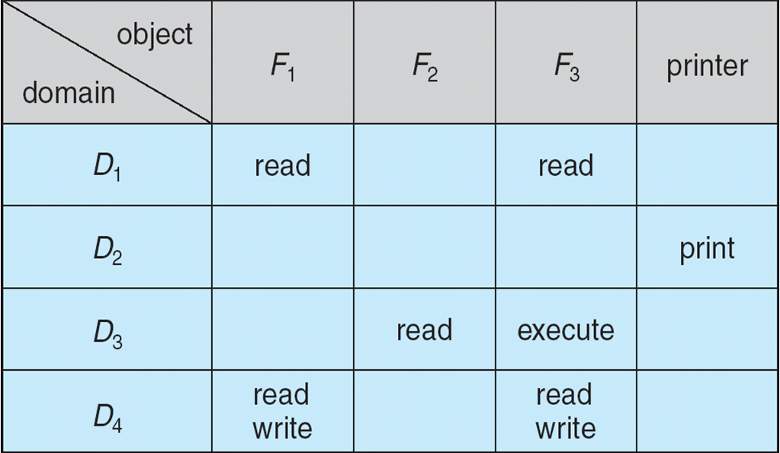
Access Matrix
View protection as a matrix (access matrix)
Rows represent domains
Columns represent objects
Access(i, j) is the set of operations that a process executing in Domain_{i} can invoke on Object_{j}

Slide 5
Thank You

